Slide 1
Frank de bank Maarten Marx Lorenzo Miechielsen Filip Kolb Egemen Alkan Mark Vaikul
Team Benchmark

Slide 2
Summary
Introduction
What & How?
Live Demo
Strong points & improvements
Retrospective
Cost Analysis
Conclusion

Slide 3
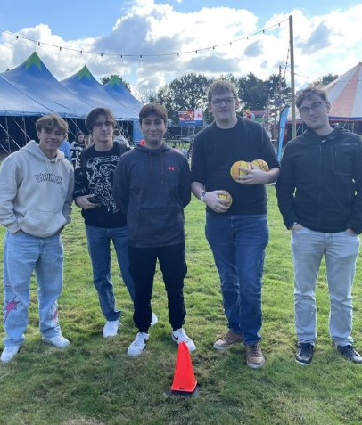
Introduction

Slide 4



Introduction

Slide 5

Proof of concept

Slide 6
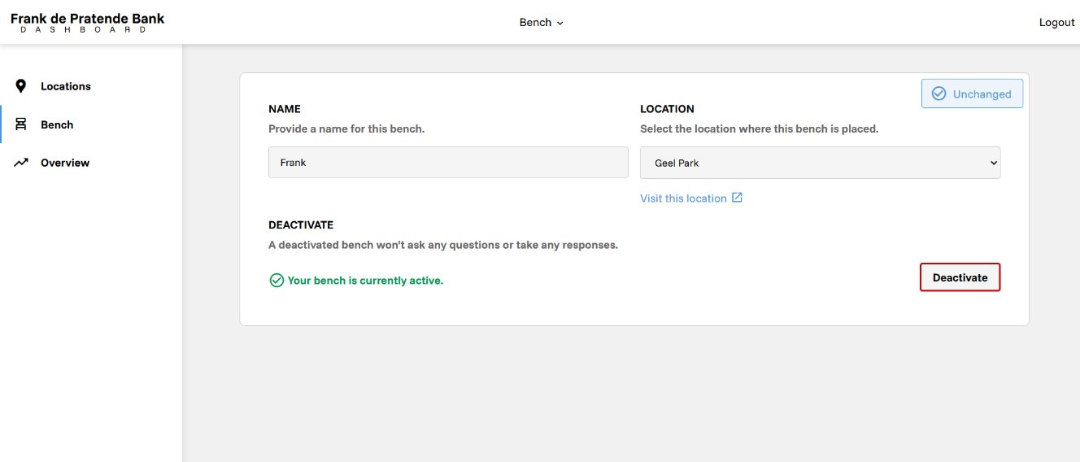
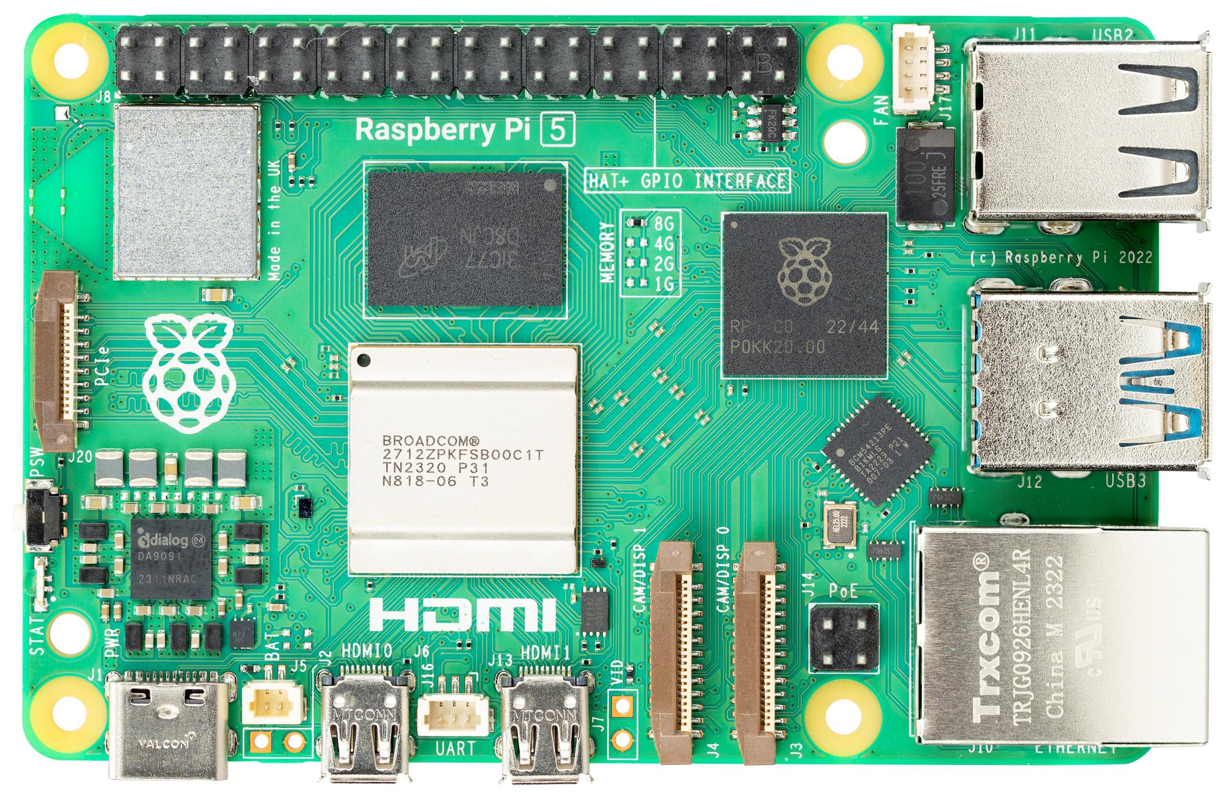

What & how?

Slide 7

Live demo

Slide 8
Strong points
LLM
Emotion detection
User friendly
Good overview of data

Slide 9
Points of improvement
API Security
Voice recognition
Automation (on and off for microcontroller)

Slide 10
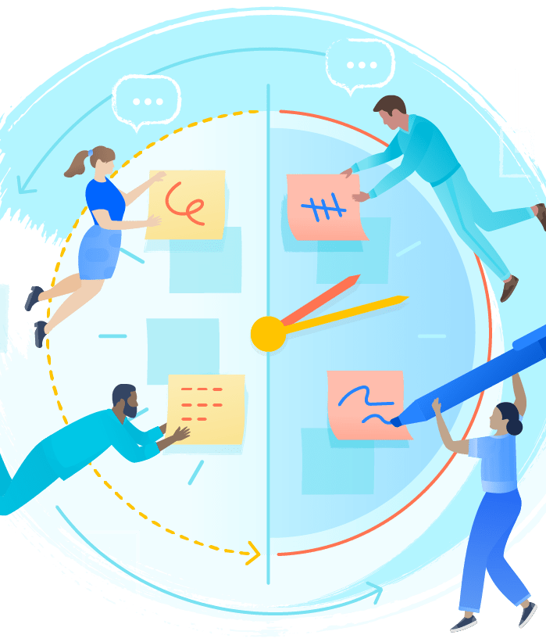
Retrospective

Slide 11
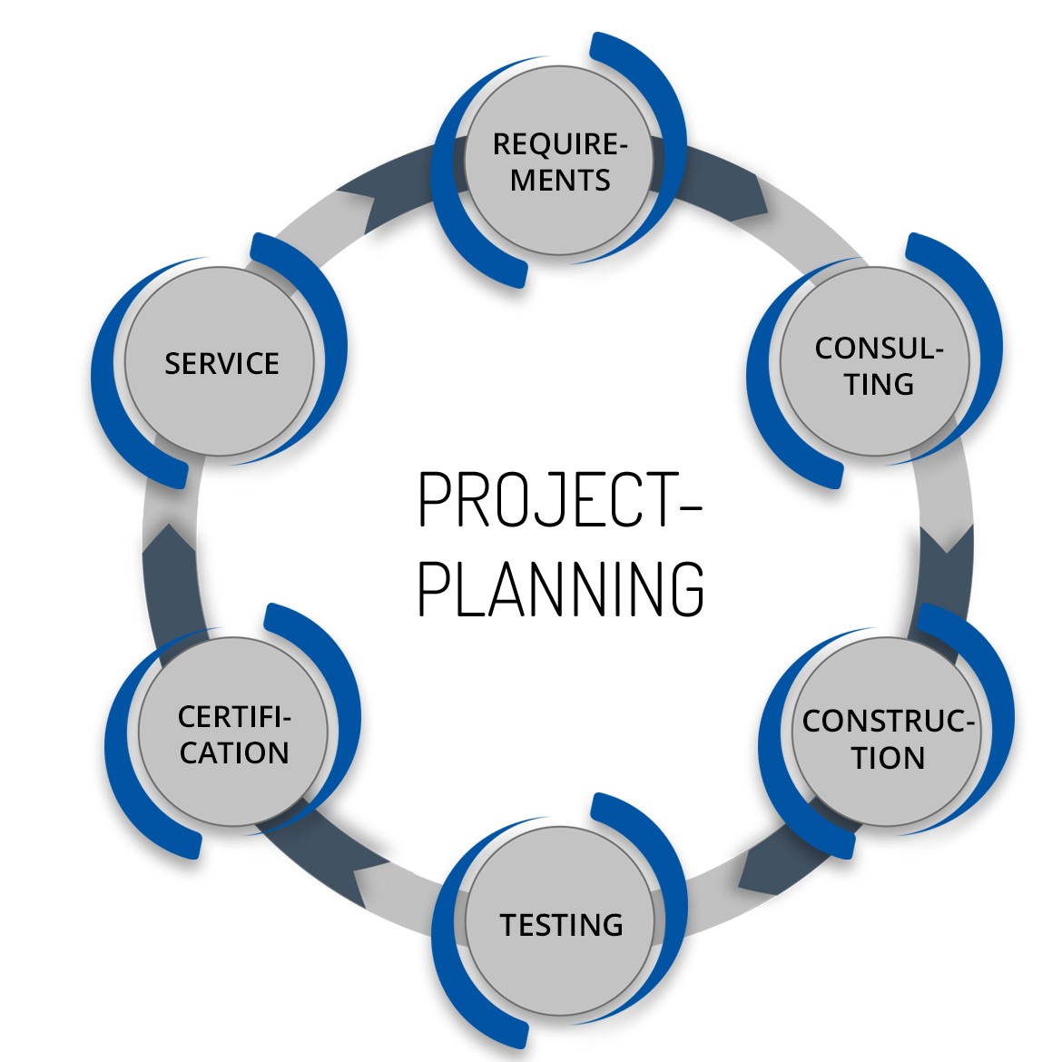

Hard skills Development

Slide 12


Soft Skill Development

Slide 13

Cost Analysis

Slide 14
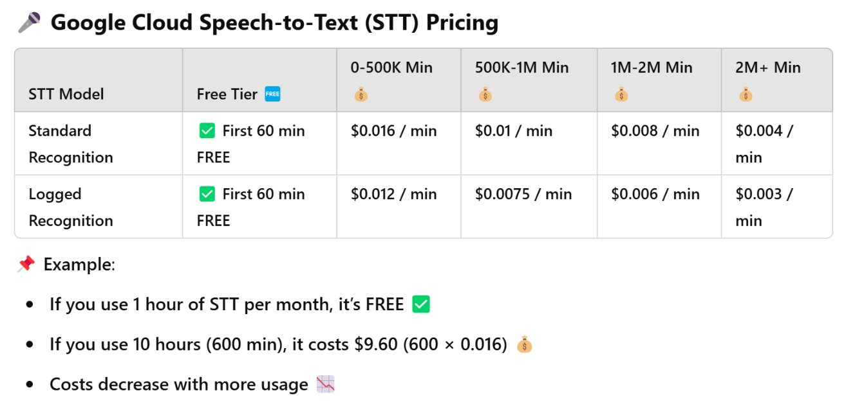
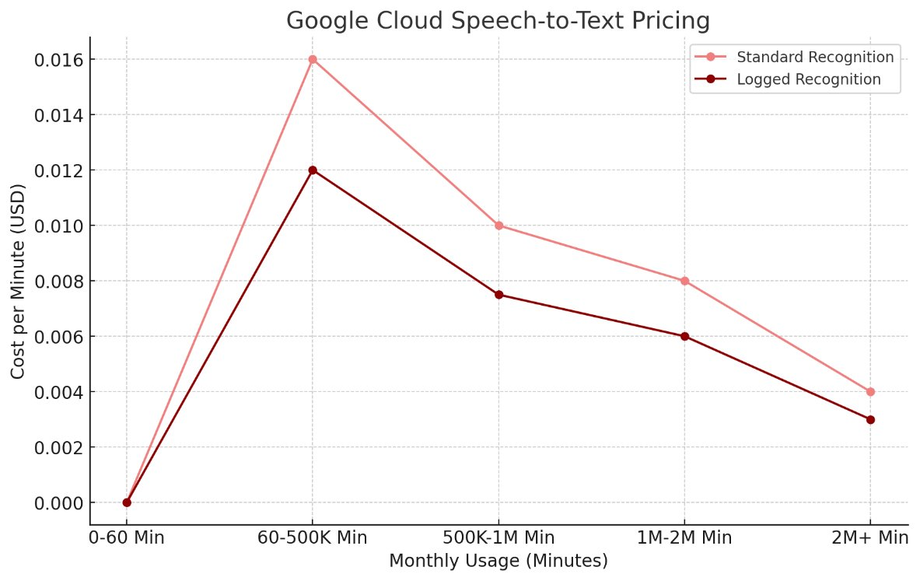
Ai costs: STT

Slide 15
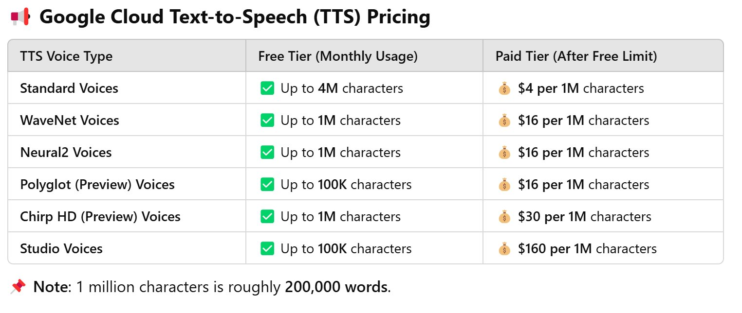
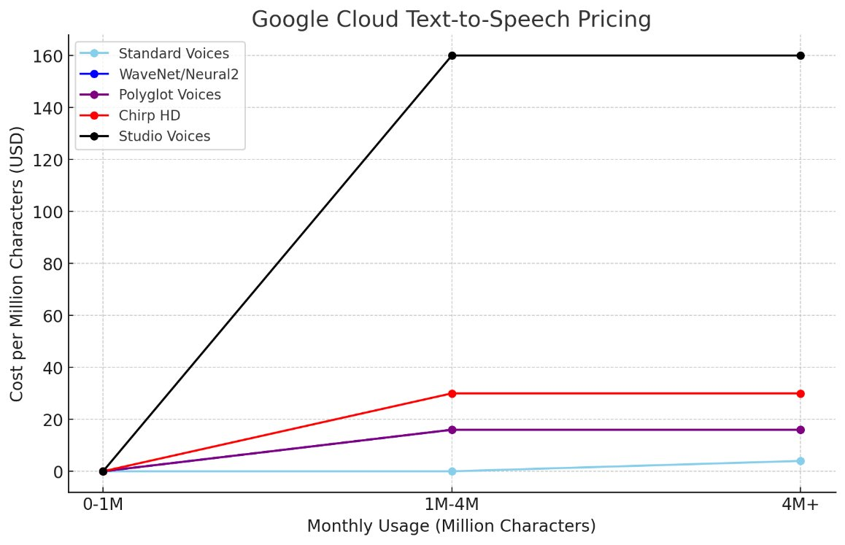
AI costs: TTS

Slide 16
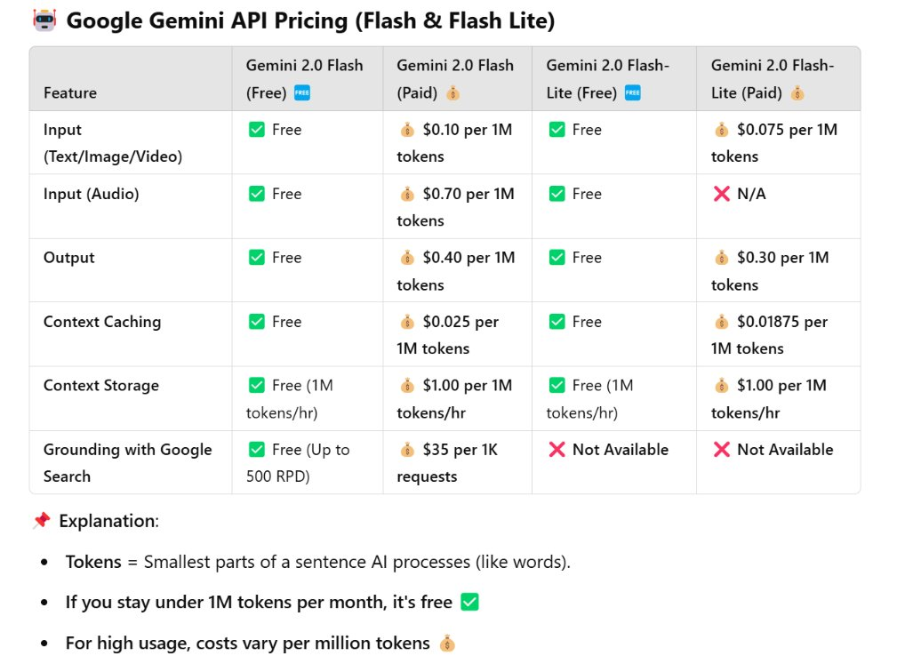
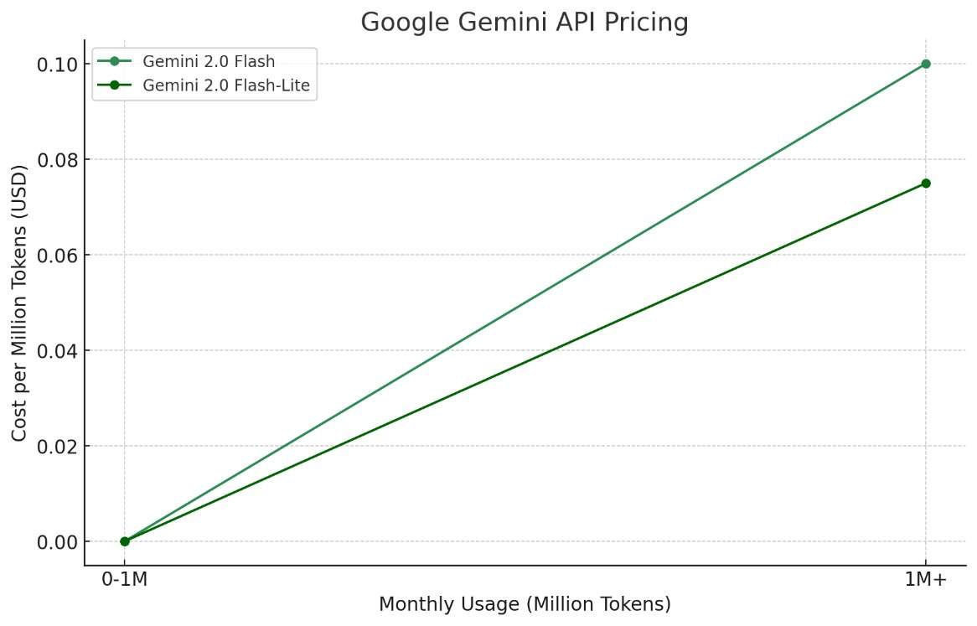
AI cost: Gemini LLM

Slide 17
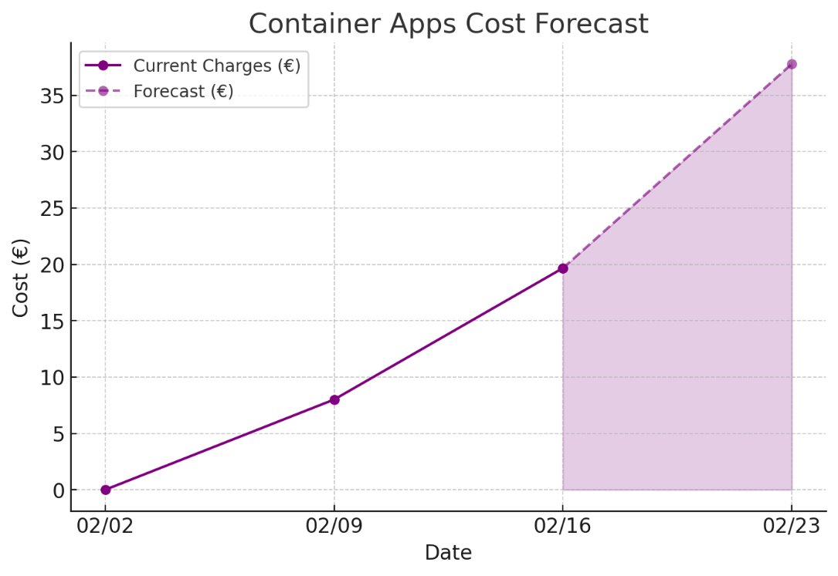
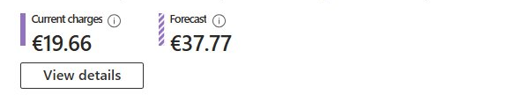
Infra costs: Contrainer apps

Slide 18
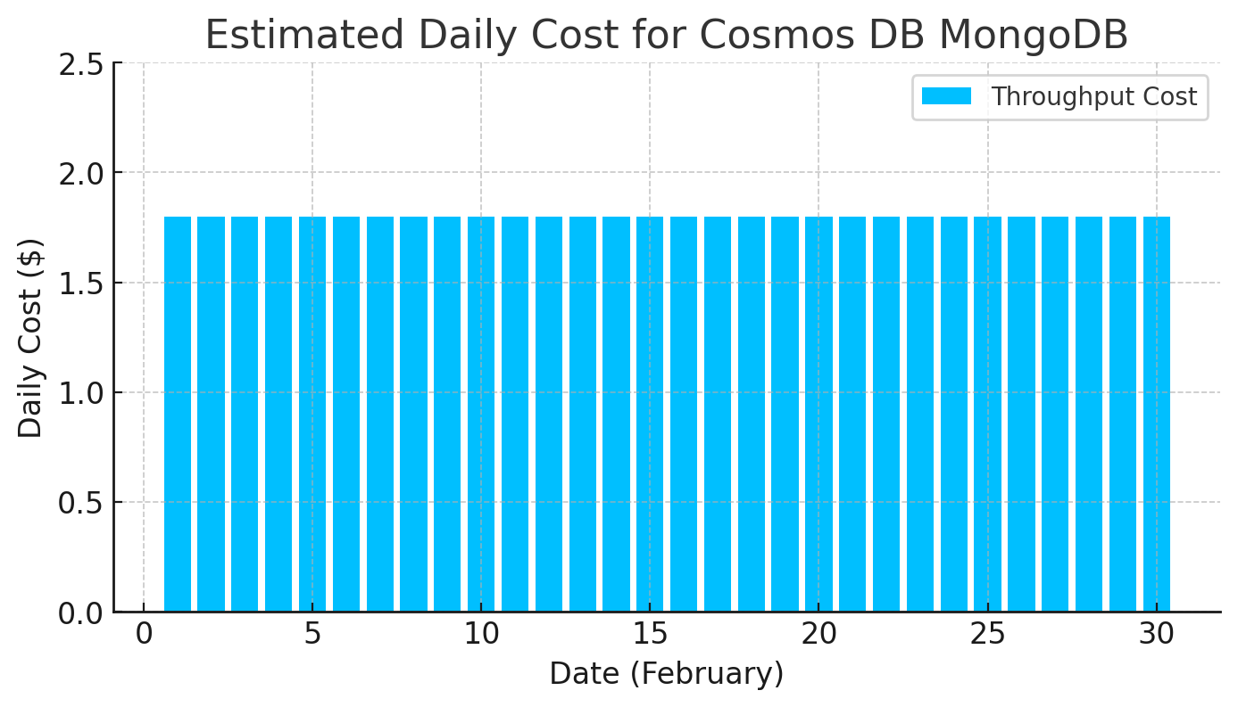
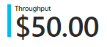
Infra costs: Database

Slide 19
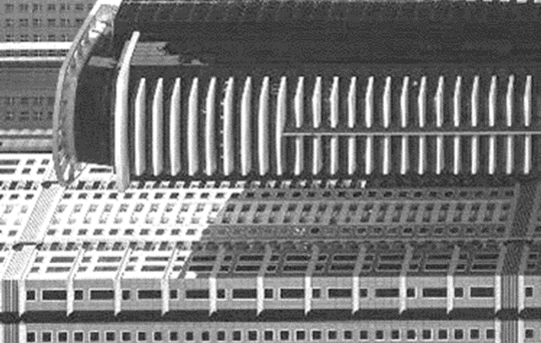
Conclusion

Slide 20
Questions?
?

